Slide 1

Hi Guys , My name is John.
I am doing a study that involves statistical analysis of data?
What type of (quantitative) data are you collecting?
Will there be enough data to achieve statistical significance?
You can answer all this question once you know the basics of Statistics.
Let’s Start

Slide 2


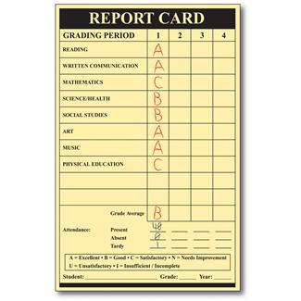



Types of data
Continuous
  Equal increments
Ordinal/Rank
  In order but not equal (Likert)
Categorical
  Names

Slide 3
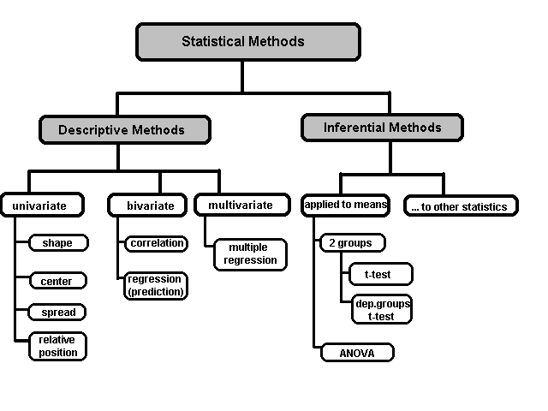
A Taxonomy of Statistics

Slide 4
Public and Private Data
There are two major kinds of data which can be classified according to the source:
Public data
Private data
A large amount of data collected by the government or other public agencies is made public for the purposes of research. Such data sets do not require special permission for access and are therefore called public data.
On the other hand, private data is that which is sensitive to organisations and is thus not available in the public domain. Banking, telecom, retail, and media are some of the key private sectors that rely heavily on data to make decisions.

Slide 5
PUBLIC DATA
PRIVATE DATA
Public Data isn’t always relevant
Client Data isn’t easy to get

Slide 6
A large number of organisations seek to leverage data analytics to make crucial decisions. As organisations become customer-centric, they utilise insights from data to enhance customer experience, while also optimising their daily processes.
Examples of Private Data
Examples of Public Data
1.Banking Data
2.Telecom Data.
3.Human Resource Data
4.Retail Data
1.Public Data Catalogues
2.Government Data Websites
3.Census Data

Slide 7

Mean (μ)
The arithmetic average (add all of the scores together, then divide by the number of scores)
μ = ∑x / n

Slide 8

Median
The middle number (just like the median strip that divides a highway down the middle; 50/50)
Used when data is not normally distributed
Often hear about the median price of housing

Slide 9

Mode
The most frequently occurring number (score, measurement, value, cost)
On a frequency distribution, it’s the highest point (like the á la mode on pie)

Slide 10
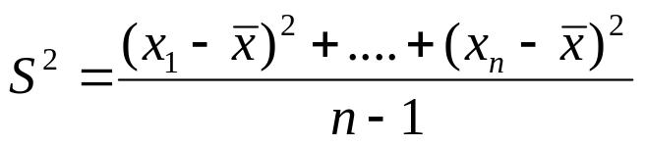
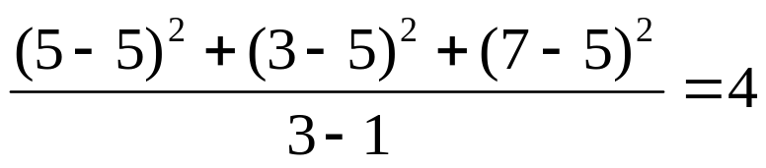
Variance
The variance of a set of observations is the average of the squares of the deviations of the observations from their mean. In symbols, the variance of the n observations x₁, x₂,…x_{n} is
Variance of 5, 7, 3? Mean is (5+7+3)/3 = 5 and the variance is
Standard Deviation: Square root of the variance. The standard deviation of the above example is 2.

Slide 11
Quartiles
Quartiles: Data can be divided into four regions that cover the total range of observed values. Cut points for these regions are known as quartiles.
In notations, quartiles of a data is the ((n+1)/4)q^{th} observation of the data, where q is the desired quartile and n is the number of observations of data.
The first quartile (Q1) is the first 25% of the data. The second quartile (Q2) is between the 25th and 50th percentage points in the data. The upper bound of Q2 is the median. The third quartile (Q3) is the 25% of the data lying between the median and the 75% cut point in the data.
Q1 is the median of the first half of the ordered observations and Q3 is the median of the second half of the ordered observations.

Slide 12
Quartiles
In the following example Q1= ((15+1)/4)1 =4th observation of the data. The 4th observation is 11. So Q1 is of this data is 11.
An example with 15 numbers
3 6 7 11 13 22 30 40 44 50 52 61 68 80 94 Q1 Q2 Q3
The first quartile is Q1=11. The second quartile is Q2=40 (This is also the Median.) The third quartile is Q3=61.
Inter-quartile Range: Difference between Q3 and Q1. Inter-quartile range of the previous example is 61- 40=21. The middle half of the ordered data lie between 40 and 61.

Slide 13
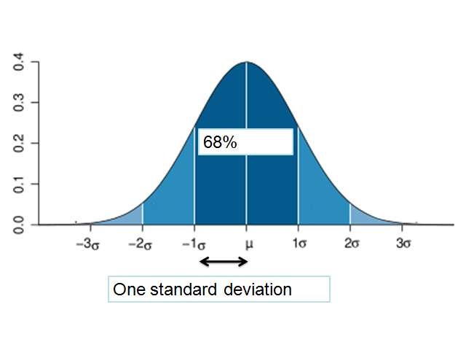
Standard Deviation (σ)
99%
95%

Slide 14
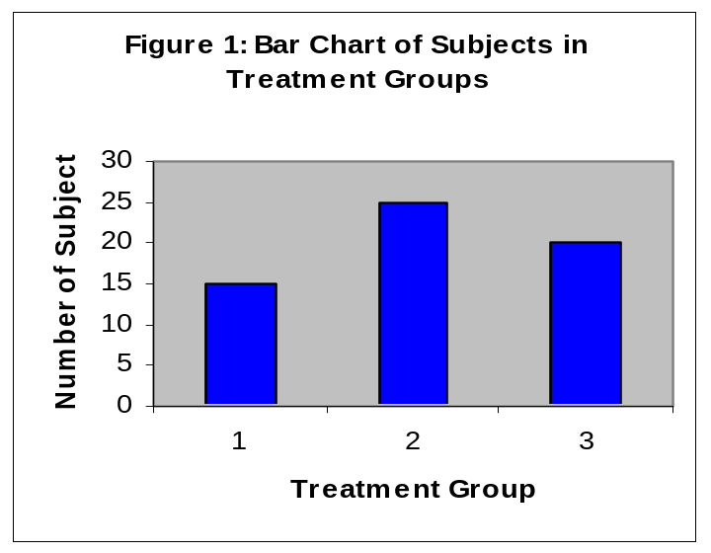
Data Presentation –Categorical Variable
Bar Diagram: Lists the categories and presents the percent or count of individuals who fall in each category.
Treatment Group | Frequency | Proportion | Percent (%)
1 | 15 | (15/60)=0.25 | 25.0
2 | 25 | (25/60)=0.333 | 41.7
3 | 20 | (20/60)=0.417 | 33.3
Total | 60 | 1.00 | 100

Slide 15
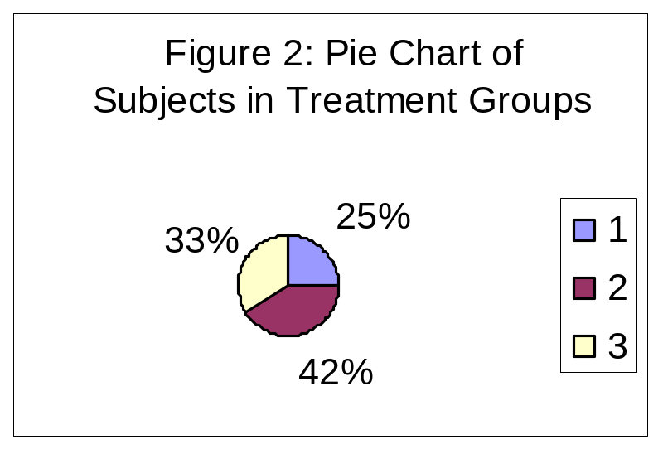
Data Presentation –Categorical Variable
Pie Chart: Lists the categories and presents the percent or count of individuals who fall in each category.
Treatment Group | Frequency | Proportion | Percent (%)
1 | 15 | (15/60)=0.25 | 25.0
2 | 25 | (25/60)=0.333 | 41.7
3 | 20 | (20/60)=0.417 | 33.3
Total | 60 | 1.00 | 100

Slide 16
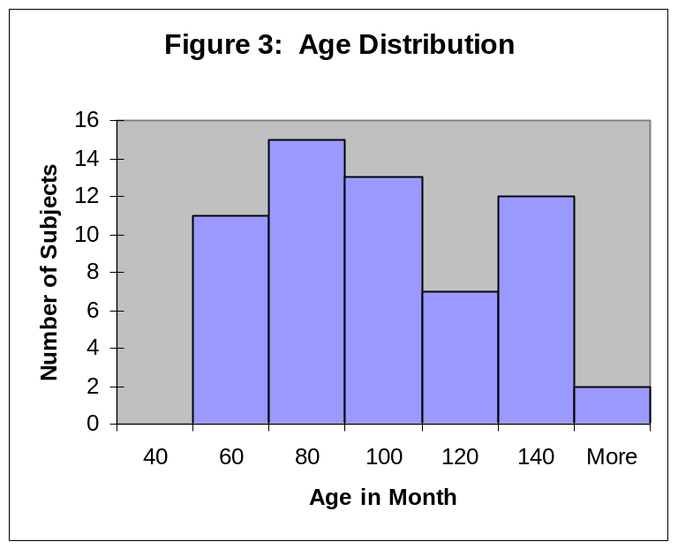
Graphical Presentation –Numerical Variable
Histogram: Overall pattern can be described by its shape, center, and spread. The following age distribution is right skewed. The center lies between 80 to 100. No outliers.
Mean | 90.41666667
Standard Error | 3.902649518
Median | 84
Mode | 84
Standard Deviation | 30.22979318
Sample Variance | 913.8403955
Kurtosis | -1.183899591
Skewness | 0.389872725
Range | 95
Minimum | 48
Maximum | 143
Sum | 5425
Count | 60

Slide 17
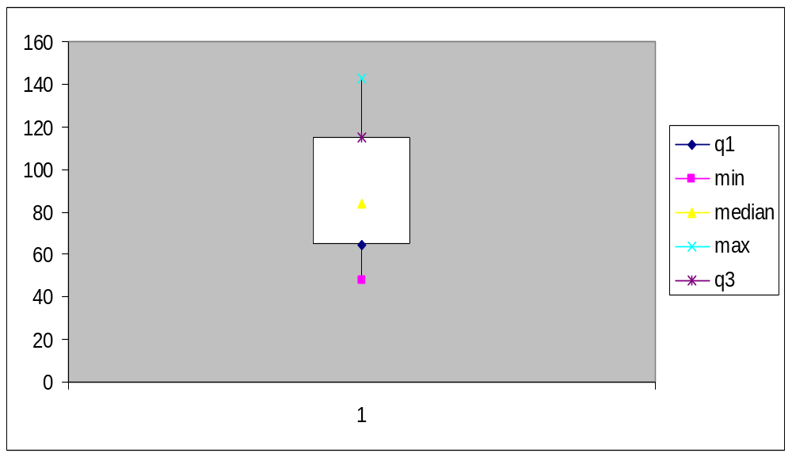
Graphical Presentation –Numerical Variable
Box-Plot: Describes the five-number summary
Figure 3: Distribution of Age
Box Plot

Slide 18
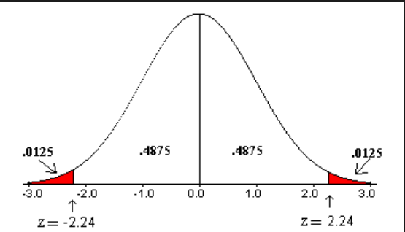
Z Test
A Z-test is a type of hypothesis test. Hypothesis testing is just a way for you to figure out if results from a test are valid or repeatable. For example, if someone said they had found a new drug that cures cancer, you would want to be sure it was probably true. A hypothesis test will tell you if it’s probably true, or probably not true. A Z test, is used when your data is approximately normally distributed.

Slide 19
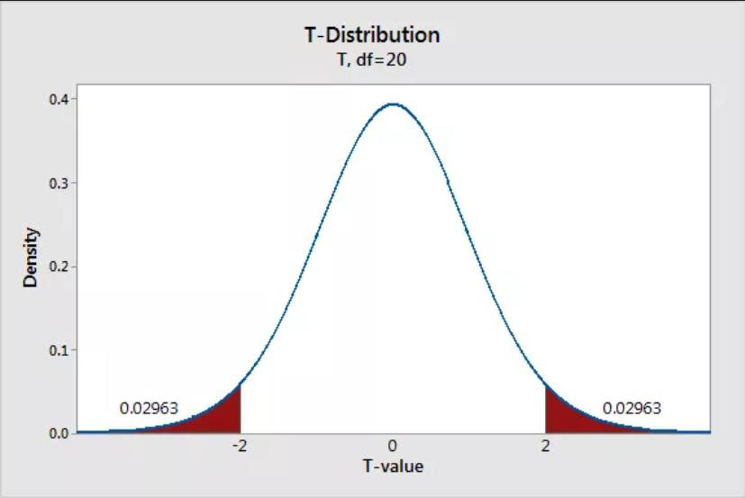
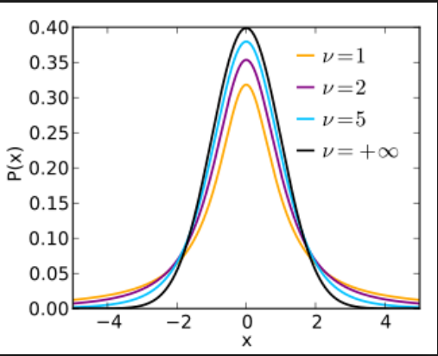
T Test
The T distribution (also called Student’s T Distribution) is a family of distributions that look almost identical to the normal distribution curve, only a bit shorter and fatter. The t distribution is used instead of the normal distribution when you have small samples (for more on this, see: t-score vs. z-score). The larger the sample size, the more the t distribution looks like the normal distribution. In fact, for sample sizes larger than 20 (e.g. more degrees of freedom), the distribution is almost exactly like the normal distribution.

Slide 20
Confidence Interval
➢ A confidence interval is expressed in terms of a range of values and a probability (for example, my lectures are between
60 and 70 minutes long 95% of the time).
➢ 95% confidence interval is what which is the most commonly used confidence level.
➢ Other commonly selected confidence levels are 90% and 99%, and the choice of confidence level to be used when constructing an interval often depends on the application.

Slide 21
Confidence Interval
➢ 90% Confidence Interval for the mean score of the students is [75-80].
➢ Does this mean that,
• 90% of the students have a score in this range?
• Mean score of the class lies in this range?
• Mean score is in this range, 90% of the time?

Slide 22
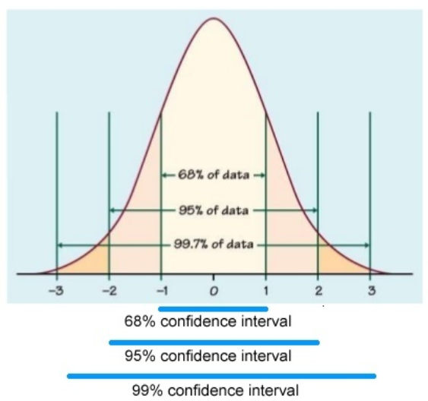
Confidence Interval
➢ A 95% confidence interval is a range of values that you can be
95% certain and contains the true mean of the population.
➢ This is not the same as a range that contains 95% of the values.

Slide 23
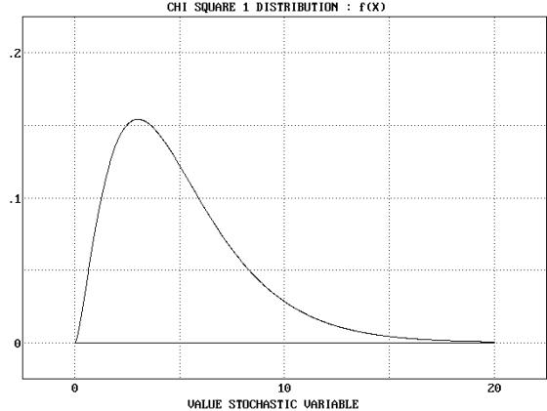
Chi-Square (χ²)
Any number squared is a positive number
Therefore, area under the curve starts at 0 and goes to infinity
To be statistically significant, needs to be in the upper 5% (α = .05)
Compares observed frequency to what we expected

Slide 24


